Slide 1




Slide 2

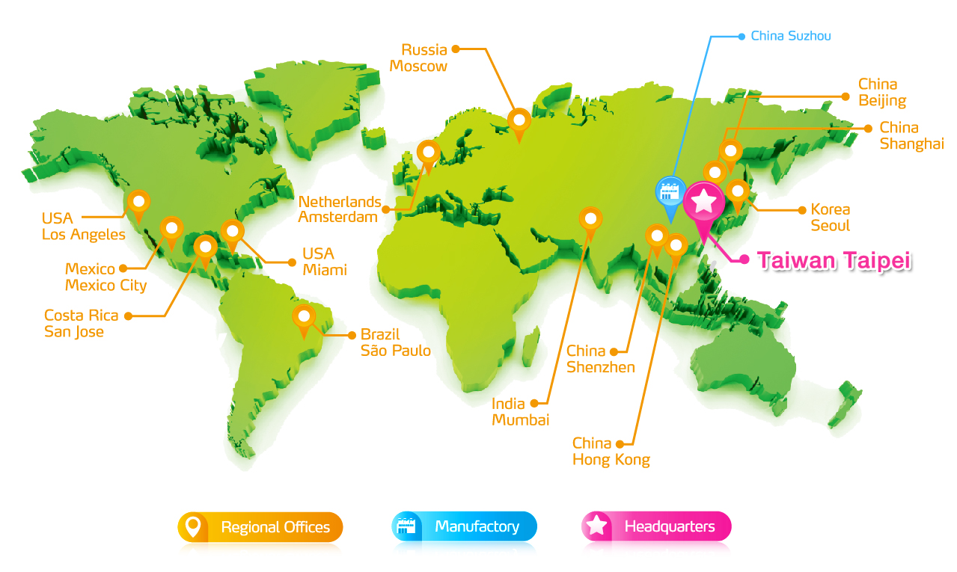


Global Service and Worldwide Presence
Global Service and Worldwide Presence

Slide 3


China Suzhou Introduction

Slide 4
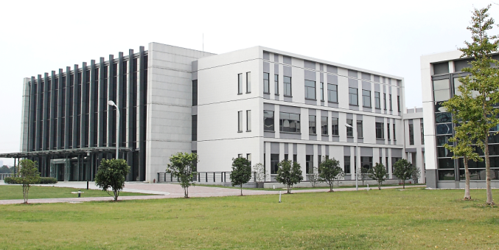
China Suzhou Factory Introduction
SuZhou, China
Established: January, 2004
Number of employees: 1000
Product Lines: DRAM Modules, USB Flash Drives,
External Hard Drives, Solid State Drives,
LED Lighting
SMT | Suzhou, China | 12 Lines
Module / Monthly | Suzhou, China | 2.5 M
Flash / Monthly | Suzhou, China | 3.5 M
LED/Monthly | Suzhou, China | 200 K

Slide 5
Mission for ADATA (Suzhou)
  To develop OEM/ODM business
  To set up China R&D and Customer Service centers
  To provide China regional customers with high quality products and services
  To establish the largest manufacturing base
Our vision:
To be the Global Leading Memory Application Provider

Slide 6

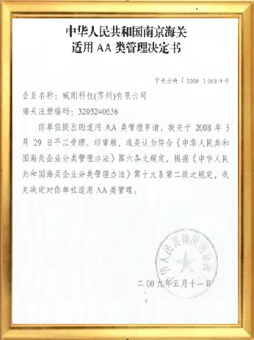
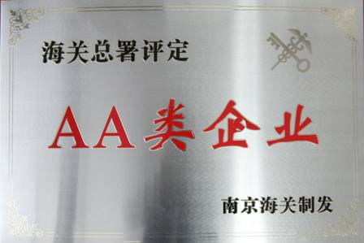
Grade AA Enterprise – the highest honor in China
Company | City Located | Enterprise Graded
ADATA | SuZhou | AA
ADATA Suzhou distinguished itself with state-of-the-art facilities and earned AA-grade qualification, the highest honor in China. There are more than 3,000 enterprises in Suzhou Industrial Park, 95% are foreign investment from Europe/USA/Japan/Taiwan, amount all only 13 of them have been granted as “AA” grade. The honor of AA grade also proves ADATA’s logistics management ability and secured trading process confirmed by customs.

Slide 7

Overview(ADATA Suzhou)
3
2
2
1
1
Items | Finished Date | Land space (m²) | Floor space (m²)
1-Finshed | Q4 2006 | 20,380m² | 57,460m²
2-Finshed | Q4 2010 | 7,357m² | 26,121m²
3 | Planning | 16,480m² | 35,130m²
Total |  | 44,217m² | 118,711m²
44,217m² Land space (m²)+ 82,843m² Green road space (m²)= 127,060m ²

Slide 8



SZ Factory Quality and Environmental Certifications
It is our commitment to provide finest quality and service for customers' complete satisfaction.
Industry Certifications and Partnerships
ISO 9001
ISO 14001
OHSAS 18001
QC080000
Green Partner
RoHS
WEEE

Slide 9
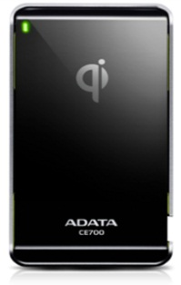
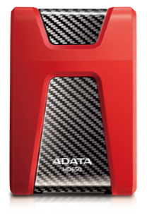
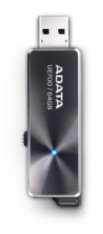

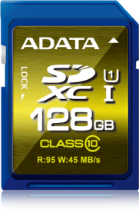

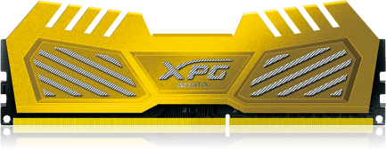
Product Lines-Memory
We are dedicated to the design, manufacturing and sales of consumer and commercial product lines that make ADATA a complete storage solutions company
Mobile Accessories
External
HDD
USB Flash Drives
Memory Cards
Solid State Drives
DRAM Modules

Slide 10
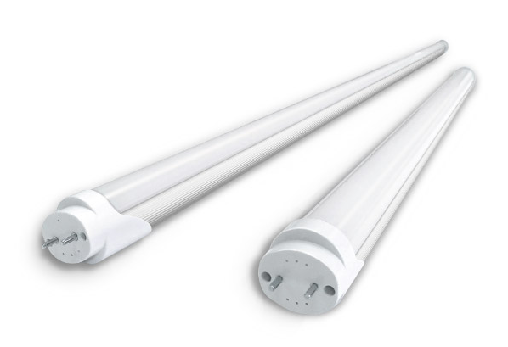
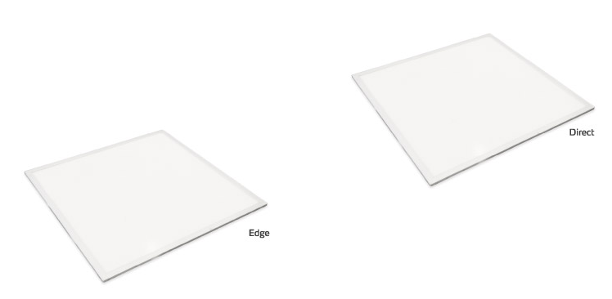
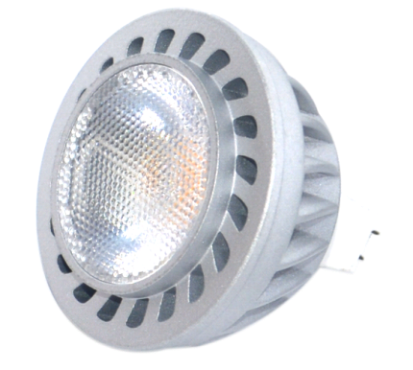
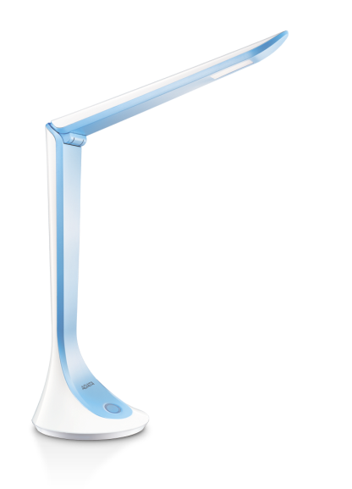
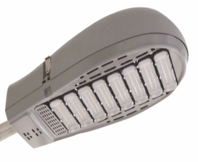
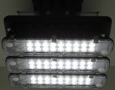
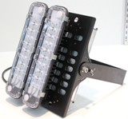
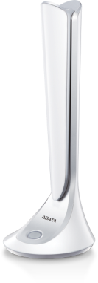
Product Lines-LED Lighting
We are dedicated to the design, manufacturing and sales of consumer and commercial product lines that make ADATA a complete storage solutions company
LED
Tube
Panel
Light
MR 16
Streetlight
Patio light
spot lighting
Desk Lighting

Slide 11



